Slide 1
Progress Social Responsibility
Door: D.A.S. Server
Opdrachtgever: NVVN

Slide 2


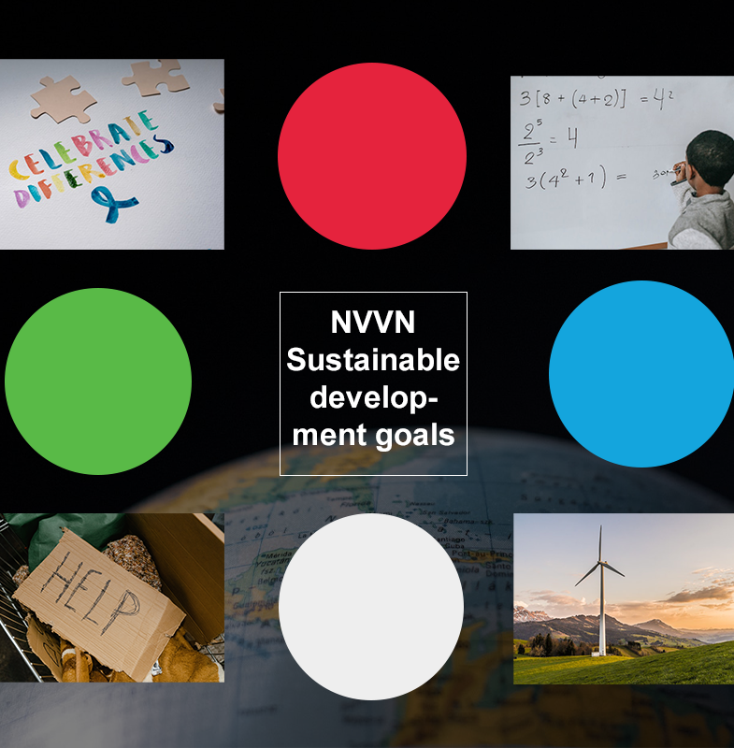
Moodboard

Slide 3
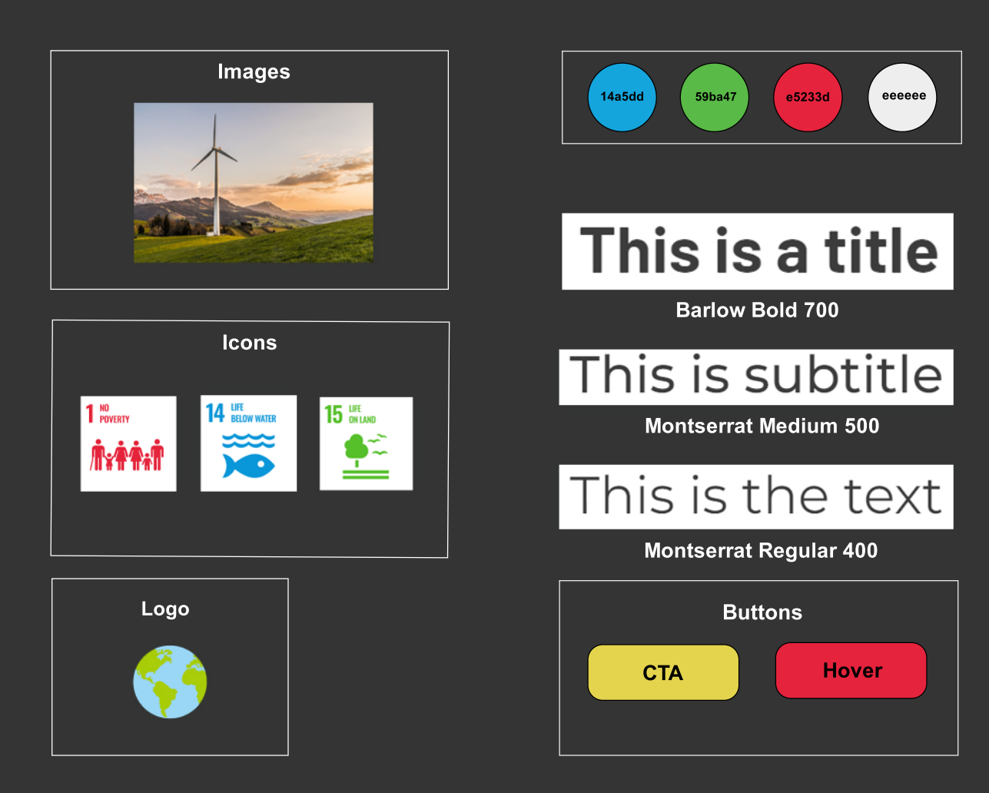
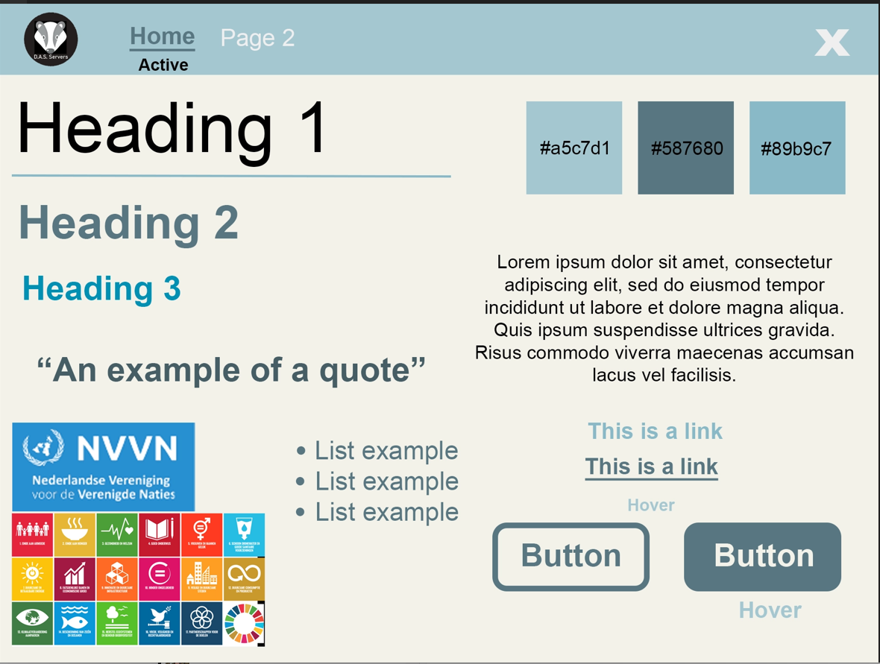
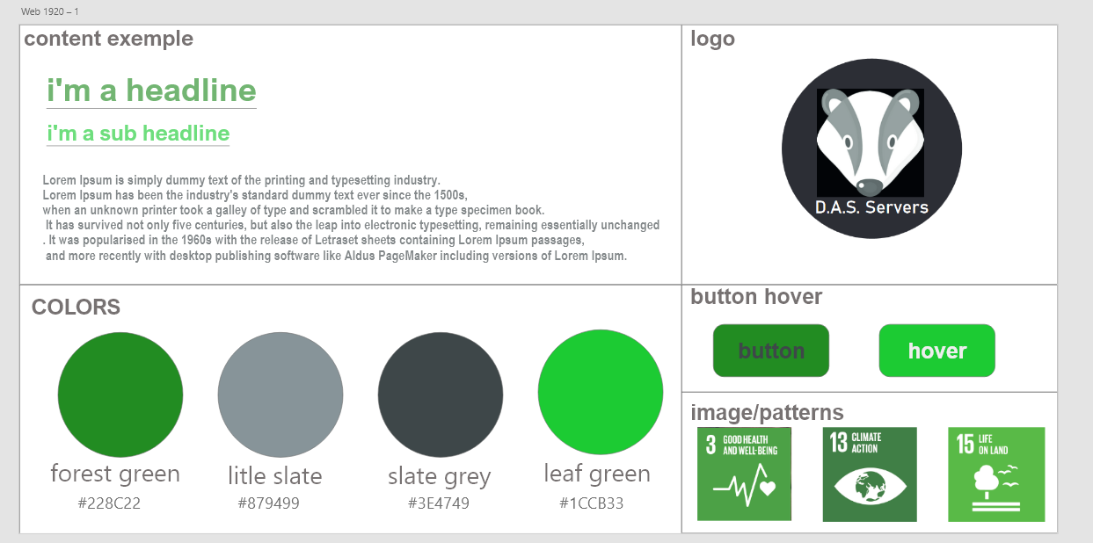
Style tiles

Slide 4
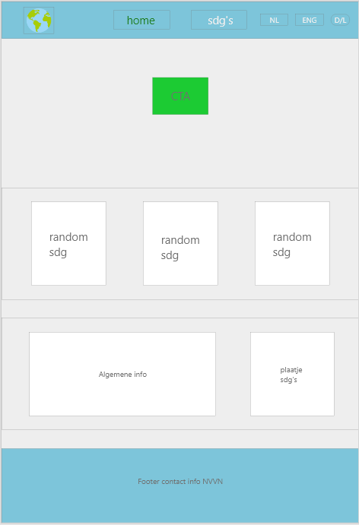
Wireframe

